Slide 1
Adding Contextual Data to the Historical Thesaurus of English

Slide 2
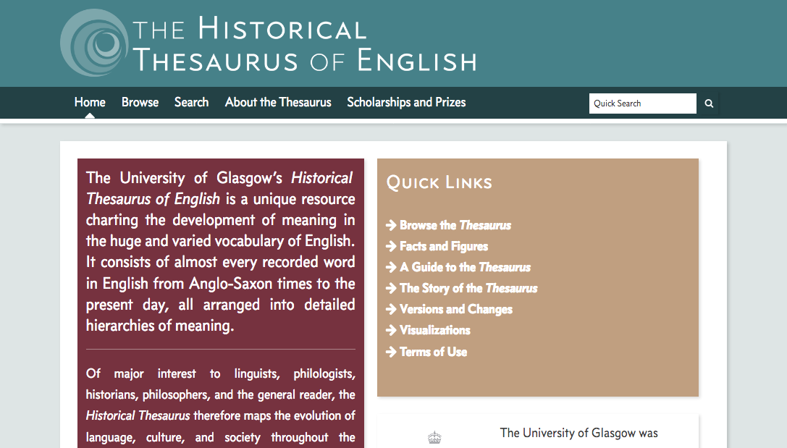
The Historical Thesaurus of English

Slide 3
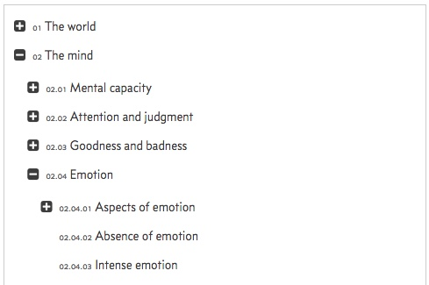
Structure

Slide 4
Structure

Slide 5
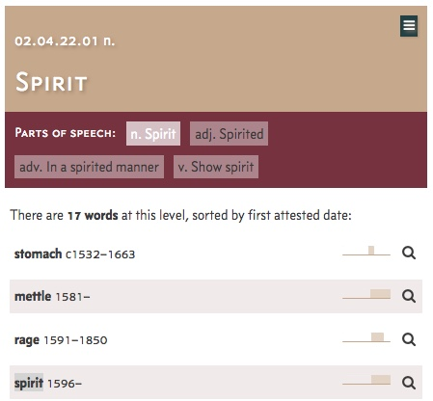
Contents

Slide 6
Polysemy
01.02.01 n.
Source/principle of life (c1250–)
01.02.01 vt.
Impart vital principle (1629–1717)
01.02.03.19.05|01.05 n.
The body :: Secretion :: fluid secretion :: spirits (1387–1812)

Slide 7
Polysemy
01.07.02.02.06 n.
Drink :: Distilled drink (1610–)
01.17.03.02 n.
Supernatural being :: Ghost/phantom (1483–)

Slide 8
Polysemy
AG.01.y.01 n.
Drink :: Distilled drink (1610–)
AQ.03.b n.
Supernatural being :: Ghost/phantom (1483–)

Slide 9
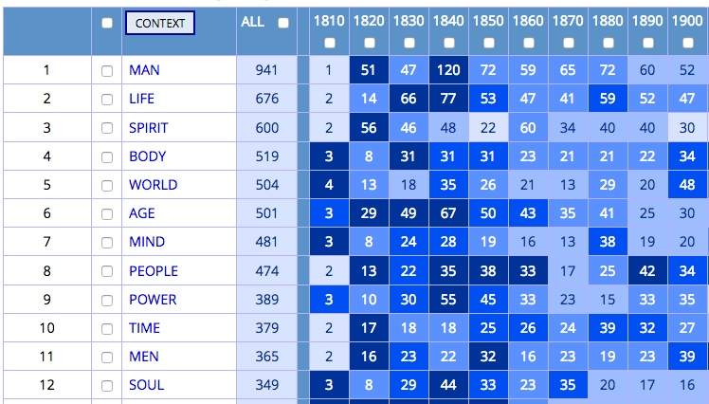
Collocates

Slide 10





Semantically-Annotated Corpora
Semantic Annotation and Mark-Up for Enhancing Lexical Searches (SAMUELS)

Slide 11
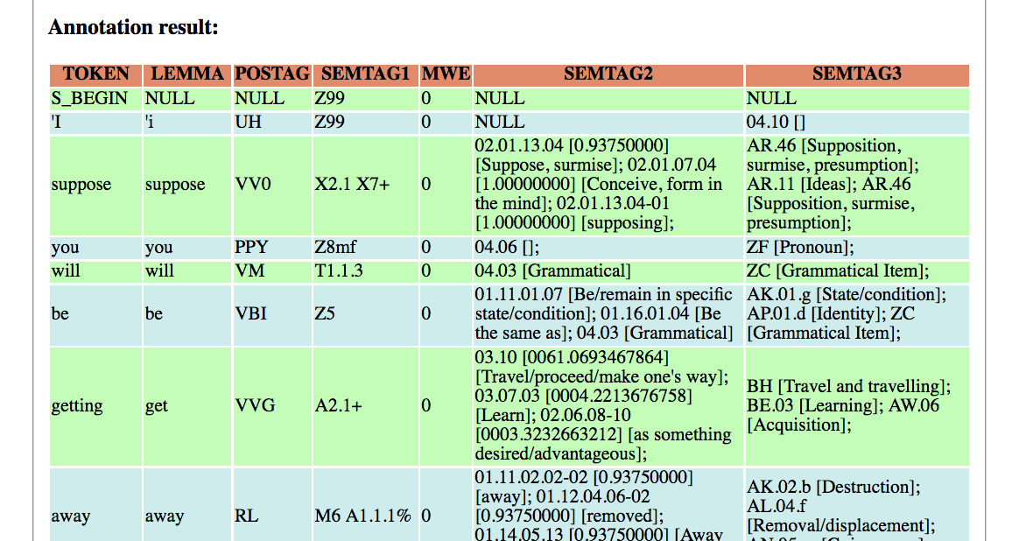
Semantically-Annotated Corpora

Slide 12
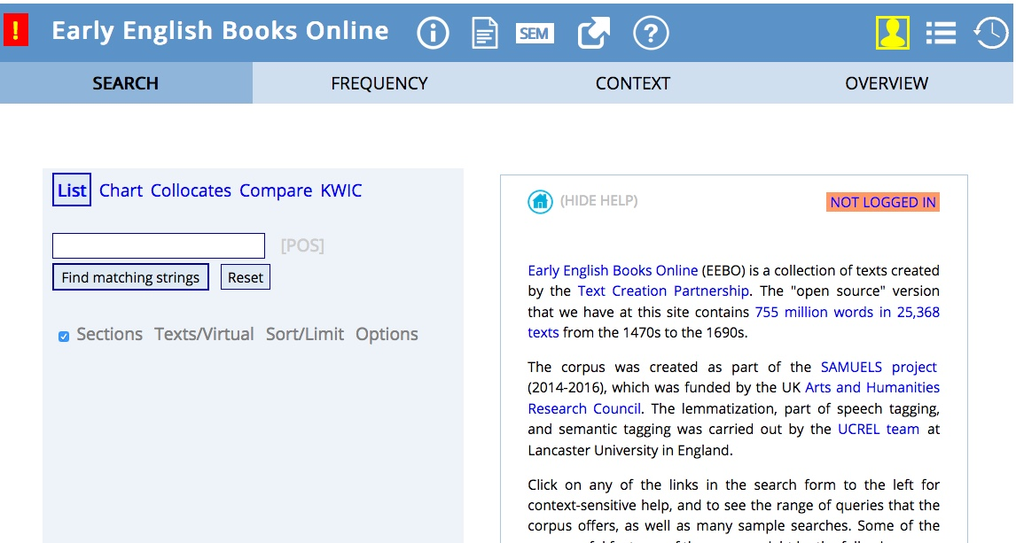
Semantically-Annotated Corpora

Slide 13
Possible Format?
Category
  Word
    Collocate of word (16th C) [x5?]
    Collocate of word (17th C)
  Word
    Collocate of word (16th C)
    Collocate of word (17th C)
  Word
    Collocate of word (16th C)
    Collocate of word (17th C)

Slide 14
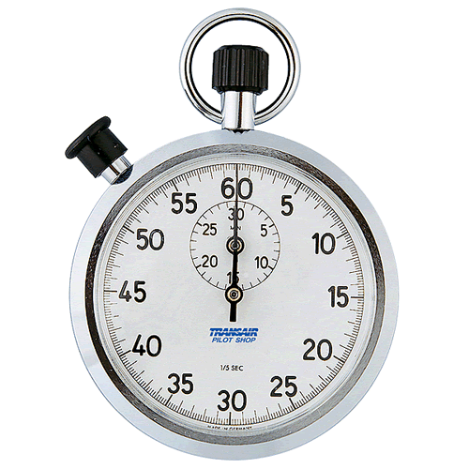
Time’s Up!
About your speaker:
  Name: Fraser Dallachy
  Institution: University of Glasgow, UK
  Social Media: @fraserdallachy
  Quick bio: Lecturer in historical semantics and corpus linguistics; interests in book history and stylistics

